Slide 1




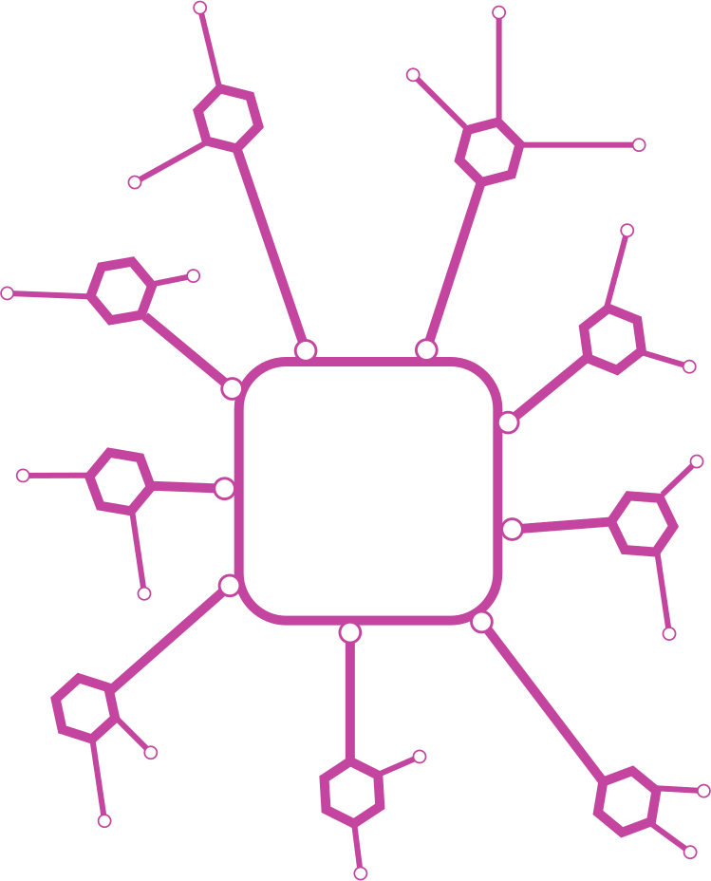

DocInsight-AI
- By Team NASA

Slide 2

Aishly Manglani
Team Members
Syeda Nida Khader
Sheetal Yadav
Amrutha Junnuri

Slide 3


Solution Description
Problem statement:
Summarizing and Analyzing legal contracts or documents is a laborious task that involves risk and high possibility of human error and we come across legal clauses on a frequent basis.
DocInsight-AI is a AI-driven platform for legal document analysis that aims to reduces manual effort and human error. It has a user-friendly interface that helps to analyze the document and provide all the necessary details and insights. It uses various models to paraphrase the contract for clarity and perform sentiment analysis to identify potential risks.

Slide 4


Project
Requirements
Software: Python, Flask, Next.js.
Libraries: T5-base Paraphrasing Model, TextBlob, NLP
Datasets: SQuAD (for Q&A), CUAD (Contract Understanding).
Infrastructure: Local server or Docker containerization.
Notes:
1. Software
Python: "Our main programming language, chosen for its versatility and strong libraries for machine learning and NLP."
Flask: "We used Flask to build a lightweight backend for handling app logic and APIs."
Next.js: "For the frontend, we chose Next.js to create fast, user-friendly interfaces."
2. Libraries
T5-base: "A pre-trained model used for paraphrasing text, improving document flexibility."
TextBlob: "A library for basic NLP tasks like sentiment analysis."
NLP Tools: "Used to extract meaning and automate legal document analysis."
3. Datasets
SQuAD: "A dataset to train our model for answering legal document-related questions."
CUAD: "Focused on understanding and extracting information from legal contracts."
4. Infrastructure
Local Server: "Used for testing and debugging during development."
Docker: "Ensured our app runs smoothly across different environments."

Slide 5

USE CASES
Legal professionals can Analyze contracts faster for high risk clauses
Users seeking contract clause explanations
Risk assessment in legal documents
Contract comparison and analysis
Automated clause extraction
Simplified legal text interpretation using the explain response feature

Slide 6




System
Architecture
Presentation Layer (Frontend)
User Interface Components
Sign-In via Google authentication
Generate response based on given questions for the ease of user
Explain response feature to get meaningful insights
Application Layer (Backend)
Document processing pipeline
Integration with ML models
Data handling and management
Processing Layer (ML models)
Reading Comprehension Model (SQuAD dataset based)
T5-base Paraphrasing Model(Chatgpt Paraphraser)
TextBlob Sentiment Analysis
CUAD Dataset Integration (500 contracts)

Slide 7

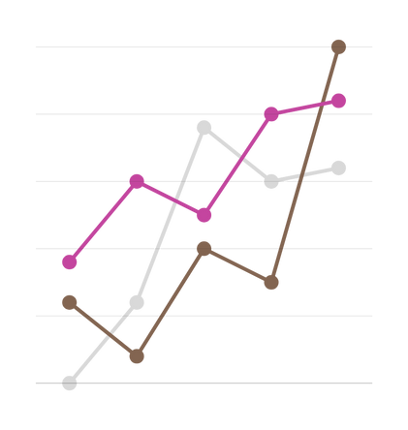
Stages of Development
1
Planning
Automate legal document analysis to improve efficiency and accuracy.
Key Activities:
Identify project goals: Paraphrasing, sentiment analysis, Q&A extraction.
Define stakeholders: Legal professionals, students, working professionals.
Conduct feasibility analysis: Assess tools like T5, TextBlob, CUAD, and SQuAD datasets.
2
Requirement analysis
Determine functional and non-functional requirements.
Key Activities:
Collect requirements: Document upload, NLP processing, result visualization.
Define datasets: SQuAD for Q&A, CUAD for contract analysis.
Set technical requirements: Python for backend, Next.js for frontend, Docker for deployment.
Notes:
Planning
"The goal was to automate legal document analysis to save time and increase accuracy. We identified key tasks like paraphrasing, sentiment analysis, and Q&A extraction. We also looked at the tools we’d need, like the T5 model, TextBlob, and datasets like SQuAD and CUAD."
Requirement Analysis
"Next, we figured out the features we needed. The app should allow document uploads, process them using NLP, and display results. We chose SQuAD for Q&A and CUAD for contract analysis. We also decided to use Python for the backend, Next.js for the frontend, and Docker for easy deployment."

Slide 8

3
Design
Create system architecture and UI/UX designs.
Key Activities:
Design system architecture:
Frontend: Next.js-based user interface.
Backend: Flask-based API for NLP model interaction.
Develop workflows: Data preprocessing, model processing, results display.
Design datasets: Store and manage processed documents.
Prototype UI: Ensure intuitive navigation for users.
4
Development
Build the system as per design specifications.
Key Activities:
Backend Development: Implement Flask APIs and integrate pre-trained models (T5, TextBlob, CUAD).
Frontend Development: Build a responsive interface using Next.js.
Dockerization: Containerize the application for deployment.
Output: Fully functional application.
Notes:
Design
"Then, we designed the system. The frontend was built using Next.js for a smooth user interface, while Flask powered the backend to handle NLP tasks. We also mapped out workflows for data preprocessing, model interaction, and displaying results. We created an intuitive UI prototype to ensure ease of use."
Development
"In this stage, we built the system based on our designs. We developed the backend with Flask, integrating models like T5 and TextBlob. For the frontend, we used Next.js to create a responsive interface. We also containerized the application with Docker to ensure easy deployment."

Slide 9
3
Testing
Ensure the system meets requirements and is error-free.
Key Activities:
Unit Testing: Test individual components like sentiment analysis and Q&A.
Integration Testing: Verify seamless frontend-backend interaction.
Performance Testing: Ensure efficient processing of documents.
Output: Test case results and a bug-free system.
4
Deployment & Maintenance
Deploy on a local server or cloud.
Maintenance:
Monitor performance, implement user feedback, update models, and fix bugs.
Output: Live, enhanced application.
Notes:
Testing
"Once the system was built, we made sure it worked smoothly. We did unit testing to check individual tasks like sentiment analysis. Then, we performed integration testing to ensure everything from frontend to backend worked together. We also ran performance tests to make sure the app handled documents efficiently."
Deployment & Maintenance
"Finally, we deployed the app either on a local server or cloud. Post-launch, we monitored performance, collected user feedback, and updated the system by improving models and fixing bugs to keep the app running smoothly."

Slide 10

WORKFLOW
01
02
03
05
04
Document Upload
Analysis Pipeline
Results Processing
Deployment
User Interaction
User uploads legal document through Next.js frontend.
Document is validated and preprocessed.
Document is processed through multiple ML models:
Reading comprehension model extracts key information.
chatgpt paraphraser from the T5-base model generates paraphrases for complex clauses.
TextBlob analyzes sentiment and implications.
CUAD dataset helps identify critical clauses.
Analysis results are aggregated.
Data is formatted for frontend display.
Insights are organized into digestible sections.
Users can run the application effortlessly by executing Docker Compose.
Results displayed through ProjectCard components.
Users can interact with analysis results.
list of questions available for users to get answers about their document in a simplified version.
Explain response functionality that enables user to understand the clause effectively.

Slide 11

ACCOMPLISHMENTS
Technical
Developed an integrated NLP system for legal applications.
Achieved effective paraphrasing using T5 and CUAD datasets.
Implemented sentiment analysis for risk detection.
Developed a reading comprehension model using the SQuAD dataset.
Created a custom CUAD dataset with 500 contracts for clause analysis.
Deployment
Dockerized the application for portability and easy deployment.
Successfully tested the system on sample legal documents.

Slide 12
UI/UX Accomplishments
Built a responsive and user-friendly interface.
Achieved seamless interaction between the frontend and backend.
Overall Achievements
Successfully implemented an automated document analysis system.
Integrated the T5-base model for accurate paraphrasing.
Implemented sentiment analysis using TextBlob.

Slide 13
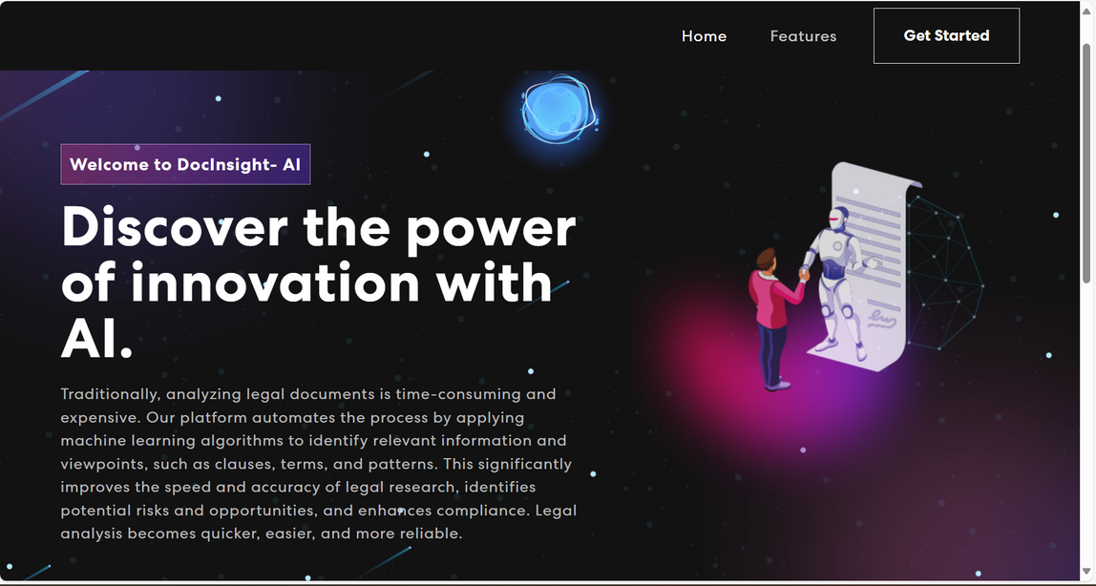
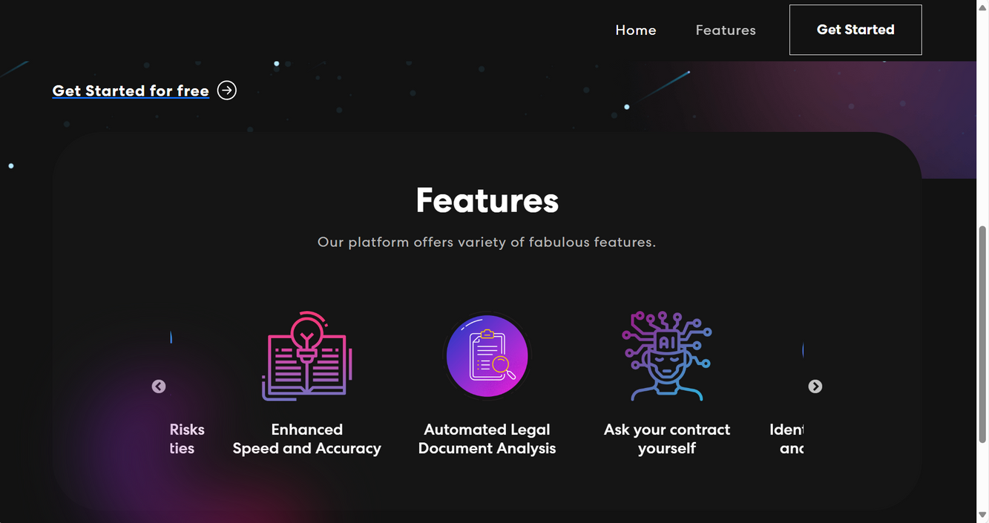

Slide 14
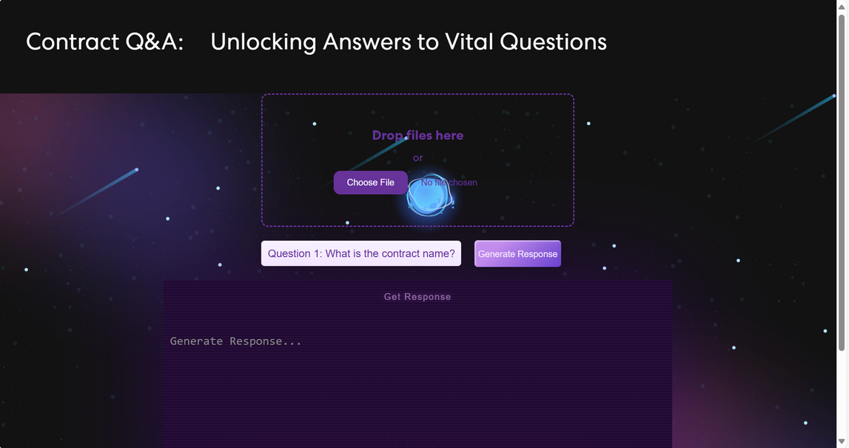
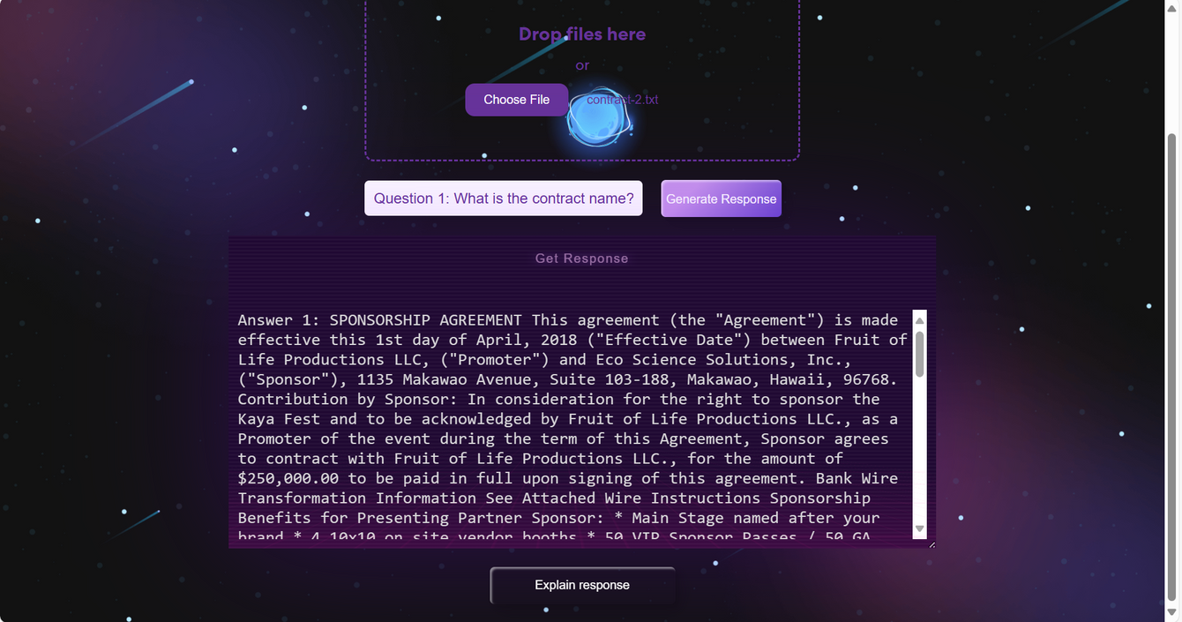

Slide 15

Demo
DOCINSIGHT-AI IS TRANSFORMING LEGAL DOCUMENT ANALYSIS WITH CUTTING-EDGE NLP AND MACHINE LEARNING TECHNIQUES
https://github.com/syedanida/DocInsight-AI

